Slide 1


Webinar 1
Decoding ACCEND: Career Pathways and Core Capabilities`
Notes:
Good afternoon and a huge welcome to our very first ACCEND webinar!
Before we get started, let’s quickly confirm our tech is working: If you can clearly see my slide and hear my voice, please just give me a quick thumbs-up or a "Yes" in the chat. Thank you!
My name is Sarah, and I'm currently on secondment with the Humber and North Yorkshire Cancer Alliance as a Project Delivery Manager, focused on implementing the ACCEND framework across our region. I bring a long history in cancer care, having spent 13 years as a Clinical Nurse Specialist—9 of those as a Lead Lung Cancer CNS.
As you may know, ACCEND is a National framework initiative by NHS England for roll-out across all Cancer Alliances.
Today's Agenda and Aims
The core aim of this entire webinar series is to highlight the benefits of ACCEND, provide support for line managers in engaging their teams, and demonstrate how this framework will become a crucial element of our cancer workforce's education and career progression.
Specifically, today’s session will focus on introducing the framework and explaining why NHS England considers it so vital for the current and future stability of the cancer workforce.
During this webinar there will be several QR codes linking to different aspects of ACCEND. There will also be some slido questions at the end so have you phone handy.
Housekeeping and Platform Features
Just a few quick housekeeping points to ensure a smooth flow:
Recording: These webinars are being recorded, and we will make the presentation slides and the video available for all registered attendees afterwards.
Duration: The session will run for approximately 30 to 40 minutes, depending on the number of questions.
Interaction: Please use the platform’s features—the Chat Box is available for general comments and interaction with the group, and the Q&A feature is the best place to submit your questions.
Questions: Since I’m the sole presenter, I won't be monitoring the questions while presenting, but I will dedicate the final 10 minutes to answering all questions submitted via the Q&A box. If we happen to run out of time, I promise to follow up with an email containing the responses.
Thank you again for joining us. Let’s dive into the ACCEND framework.

Slide 2

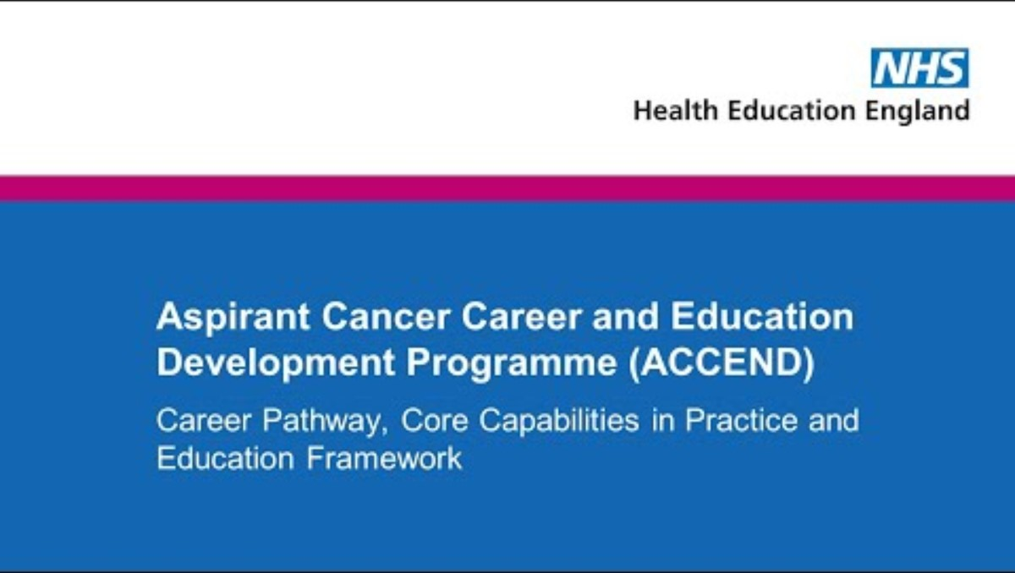
ACCEND (aspirant cancer career and education development ) programme
Notes:
This slide shows the QR code which will direct you to the ACCEND framework and I encourage you to watch this video introducing the ACCEND on the website at you convivence.
You are all part of the essential cancer workforce, and this series is designed specifically for you. It's about more than just training; it's about providing practical education and tailored support for every staff member—clinical and non-clinical—who is currently using or looking to integrate ACCEND into their professional development.
Now, I want to start by being very honest. As a Lung Cancer Clinical Nurse Specialist myself, I know exactly how precious your time is. I understand the relentless pressure of managing patient care, completing other competency frameworks, peer reviews, statutory and mandatory training, and for my fellow nurses, revalidation. You're already juggling so much.
Yes, ACCEND isn't mandated, but we all share the same ultimate goal: to provide excellent, standardised patient care across the cancer pathway. As healthcare professionals, our commitment to self-improvement is non-negotiable. With the demands of the NHS 10-year health plan reshaping secondary care, we need flexible, high-quality development frameworks now more than ever.
ACCEND is our tool to ensure we are not just keeping up with change, but driving it—striving for the best possible care we can offer every single patient. So let's get started."

Slide 3
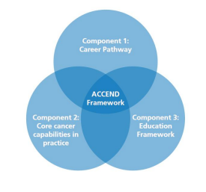
ACCEND Components
Component 1: Career Pathway this component identifies career levels for both specialist and generalist workforce.
Component 2: Core cancer capabilities - (CiPs) these are mapped against your level of practice
Component 3: Education framework - easy access to education and training
Notes:
Introducing ACCEND: The Future of Professional Practice in Cancer Care.
I am launching this webinar series to support the entire cancer workforce in seamlessly adopting the ACCEND Framework—the essential tool for career progression and continuous professional development.
ACCEND is a targeted solution designed for everyone who cares for patients affected by cancer: non-clinical, AHP, nursing, and pharmacy professionals. It moves beyond traditional banding to concentrate on levels of practice, allowing us to precisely and fairly capture everyone's true expertise and experience.
My goal today is to ensure you leave with a complete understanding of why ACCEND was created, who the framework applies to, and how to access the complimentary resources to begin your self-assessment with confidence.
The framework is made up of 3 components: Capabilities in practice, aligned education and career progression.
What are the ACCEND Capabilities? (CiPs)
Think of ACCEND's Capabilities in Practice (CiPs) as a detailed, national checklist of the essential knowledge, skills, and behaviours you need to be great at your job when caring for people affected by cancer.
They are essentially the "What good looks like" for everyone in the cancer workforce, regardless of their specific title (nurse, pharmacist, support worker, etc.).
1. They are Your "Must-Haves"
The CiPs define the minimum standards for safe, high-quality cancer care. They answer the question:
"To work effectively at my level, what do I need to know, and what do I need to be able to do?“
2. They Focus on Levels, Not Bands
This is the most important distinction. The capabilities are not tied to your pay grade or your job title (like Band 5 or Band 6). Instead, they are defined by your Level of Practice (Supportive, Assistive, Registered, Enhanced, Advanced, etc.).
Why? Because a Band 6 nurse in one area might be doing the work of an Enhanced practitioner in cancer care in another area. ACCEND focuses on your actual skills and responsibilities, not just the label on your badge.
3. They Cover Four Key Areas ("Pillars of Practice")
The capabilities aren't just about clinical tasks. They cover the four main areas that make up a successful modern healthcare professional:
Clinical Practice: Your hands-on skills. (e.g., managing personalised care, assessing symptoms, knowing about different cancers).
Leadership & Management: Your role in the team and service. (e.g., managing change, delegating tasks, being a role model).
Education: Teaching and learning. (e.g., teaching patients self-management, supervising junior colleagues, keeping your own knowledge up to date).
Research & Quality Improvement: Making things better. (e.g., using evidence to inform your work, finding ways to improve the service).
4. How They Help You (The Self-Assessment)
The capabilities are used in your self-assessment and portfolio. They give you a structured way to:
Measure Your Progress: You look at the list of CiPs for your level and ask: "Do I do this well? Can I prove it?"
Identify Development Gaps: If you find a capability you aren't meeting, it instantly becomes your goal for learning and training.
Show Your Value: They give you clear, standardised language to show managers and employers exactly what you can do, which is crucial for appraisals and career progression.
In summary: ACCEND Capabilities are the specific, measurable, and essential skills and knowledge needed to deliver excellent cancer care at every stage of a professional's career.
Simply put, the Education Framework acts as a study guide for everyone who works in cancer care.
It clearly sets out what you need to know at each step of your career to be great at your job. It takes the "Core Capabilities" (the skills and knowledge you need to do the job) and tells you how to get them.
Core Knowledge: It defines the basic cancer knowledge required for different levels of practice. For those at the beginning of their careers (like support workers and students), there's a core knowledge program called 'Foundations of Cancer Care'. For qualified professionals moving up, there's a more advanced program called 'Fundamentals of Cancer Care'.
Learning Resources: It points to the different ways you can gain this knowledge, including:
Online e-learning modules.
Workplace-based learning and reflection.
University-accredited courses, like postgraduate certificates or master's degrees.
Goals: It provides high-level learning outcomes (the goals of your learning) and a suggested syllabus to make sure all cancer staff across the UK are learning a consistent set of knowledge and skills.
The Career Progression Component
The Career Pathway part of the ACCEND framework is essentially a clear ladder for your career in cancer care, replacing old, confusing systems.
It provides a structured way for non-medical professionals (like nurses, allied health professionals, and support workers) to see how they can move up and develop their expertise in caring for people affected by cancer.
Instead of focusing on specific job titles, the framework defines seven levels of practice:
Supportive
Assistive
Pre-registration (students in training)
Registration (newly qualified professionals)
Enhanced
Advanced
Consultant
How it Works:
Defined Levels: For each of the seven levels, the framework clearly describes the characteristics, knowledge, skills, and behaviours you need to be working at that level.
Clear Path Forward: It shows you the steps you need to take in your learning and experience to progress from one level to the next. For example, it outlines what a Registered Nurse needs to learn and achieve to become an Enhanced Practitioner, and then eventually an Advanced or Consultant Practitioner.
Flexibility: It focuses on what you can do (your capabilities) rather than just what your job title is, which allows staff to develop and move across different cancer services (general or specialist) while still having their expertise recognised and valued.

Slide 4
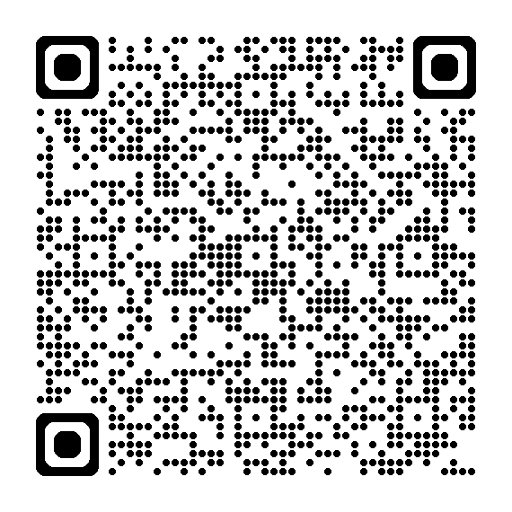
DIGITAL PORTFOLIO FEEDBACK LINK
Notes:
The Aspirant Cancer Career and Education Development (ACCEND) Learning Hub is a platform established by NHS England and partners to support and develop the non-medical healthcare workforce involved in cancer care.
Its primary focus is on providing targeted resources for the Supportive and Assistive (SA) workforce.
It provides a dedicated Supportive and Assistive Workforce Toolkit. The core support is delivered through this ACCEND Supportive and Assistive Workforce Toolkit, which is specifically designed to expand knowledge, skills, and awareness for roles like cancer support workers and healthcare assistants.
So What is available:
Foundations of Cancer Care - A multi-module online course to build a solid, foundational understanding of cancer and its treatments.
Capabilities and Development
Resources aligned with the ACCEND Framework's Core Capabilities in Practice (CiPs), including: Person-centred care, Communication skills, Psychological support, and Self-care and development.
Professional Development
Modules on essential skills such as Introduction to Coaching, The Spirit of Motivational Interviewing, and Advocating for people living with cancer.
Addressing Inequalities
Learning resources focused on Developing Cultural Competence in Cancer Care and reducing inequalities for specific communities (e.g., the LGBTQ+ community).
Practical Role Guidance
Resources like Role Profiles and short videos/animations to clarify career pathways, job expectations, and how to apply the framework in day-to-day work.
Emphasis on Wellbeing and Personal Support
Recognizing the emotional demands of cancer care, the Hub includes resources to support staff wellbeing, which is a key component of a robust supportive workforce:
Self-Care and Development: Resources to help individuals manage their emotional, physical, and mental wellbeing.
"Help for the Helpers": Modules providing guidance on maintaining an ethical approach and focusing on personal resilience and support following challenging work situations.⁶
Community of Practice: The ACCEND programme facilitates a Community of Practice, providing a forum for staff to share experiences, best practices, and receive peer support for implementation.
Career and Progression Support
The Hub is fundamentally an assistive resource for career advancement and role clarity:
Structured Career Pathways: It simplifies the ACCEND Framework, clearly outlining the seven levels of practice (Supportive, Assistive, Pre-registration, etc.) to help staff see their potential for progression.
E-Learning and Upskilling: It provides the necessary education and training, often in partnership with organizations like Macmillan, to match a practitioner's current role with the required capabilities, thereby preparing them for the next step in their career.
In summary, the ACCEND Learning Hub is a targeted, assistive toolkit that supports the cancer workforce by building specific knowledge, enhancing essential supportive skills, and providing clear, accessible pathways for professional growth.

Slide 5
The ACCEND Framework: Shaping Your Cancer Career
Defines Your Path: A national, three-part framework that maps practice from supportive roles to consultant level for all key cancer professions (supportive and assistive, pre reg, reg nurses, AHPs, pharmacy, psychology).
Clear progression pathways: Provides clear career pathways and ensures your capabilities align with essential education and training.
Empowers Development: Facilitates meaningful conversations about your growth within appraisals.
Your Digital Story: An ever-evolving digital portfolio that captures your complete skills and expertise, travelling with you across your career.
UK-Wide Integration: Fully aligned with complementary frameworks (e.g., UKONS).
Notes:
Moving Forward with ACCEND: Framework Value and Digital Transition
As we continue implementing the ACCEND framework, I want to address the status of the supporting digital tools, specifically the Digital Portfolio and the imminent RETA Hub release.
It’s important to understand that the core value of ACCEND is available to the cancer workforce right now, independent of the digital platform. We must utilise the framework's structure immediately to realise its benefits. The Humber and North Yorkshire cancer alliance is part of the Eportfolio pilot hosted on the digital learning solutions website (DSL website). This portfolio is the full framework of capabilities but at the moment has limited functions. We need staff to use the digital portfolio so was can shape what the portfolio will look like in the future. The more feedback given the better and more usable for the service users.
Defines Your Path and Guarantees Progression: The detailed, three-part framework maps practice from supportive roles to consultant level across all key cancer professions. Workforce members can use this mapping today to identify their current level, understand the required knowledge and skills for the next stage, and clarify their ultimate career destination.
Empowers Development Conversations: ACCEND provides the essential language and structure for meaningful conversations within appraisals, supervision, and team meetings. By using the framework's defined capabilities, both staff and managers can have targeted, productive discussions about development and progression. This replaces subjective conversations with an evidence-based, national standard.
The framework is designed to reduce, not increase, the administrative burden. Rather than creating new work, it structures and validates the excellent professional development already being undertaken.
No Dual Recording Required: We want to be clear: until the Digital Portfolio is live and fully integrated, we are not asking staff to create a separate "digital story." Local record-keeping (e.g., existing professional portfolios, training logs) should continue as normal.
Future-Proofing Your Work: When the Your Digital Story portfolio is released, it will serve as an ever-evolving tool designed to capture and travel with the individual, eliminating the need to re-verify skills and experience repeatedly. The effort you put into following the framework now is the foundation for a smoother, more efficient digital transition later.
In summary, please continue to use the ACCEND framework as your professional compass for career and workforce development. The digital tools are an exciting future enhancement, but they are not a prerequisite for success.
For all Managers and Supervisors: We urge you to immediately integrate ACCEND language and defined capability requirements into your upcoming appraisal, supervision, and team development cycles. By doing so, you embed the framework into routine practice and ensure staff are positioned to seamlessly populate the Digital Portfolio once it becomes available.

Slide 6
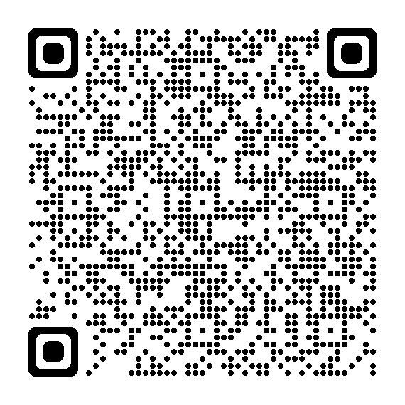
Levels of Practice
This QR code will send you to the tool for assessing what level of practice you are.
Notes:
Someone of you have spoken to me previously about understanding your level of your practice and often people often work at different levels of practice so how do we address this. The framework does clearly define levels of practice and what the workforce needs to do to work at certain level of practice but there is a national acknowledgment that many people work at different levels. The idea of ACCEND is to standardise this and if people who want to progress in their career can look at higher levels of practice and work towards this. All this is completely voluntary, but everyone should be expected to achieve the capabilities at which level of practice you are employed. To know which level of practice you should be self assessment.
This QR code will direct you to a tool which, by answering a few questions will inform you what level of practice you should self assess against according to the frameworks’ design.
In part of your practice, you may work at a higher level of practice then you should recognise this and provide evidence of this to the aligned capability.

Slide 7
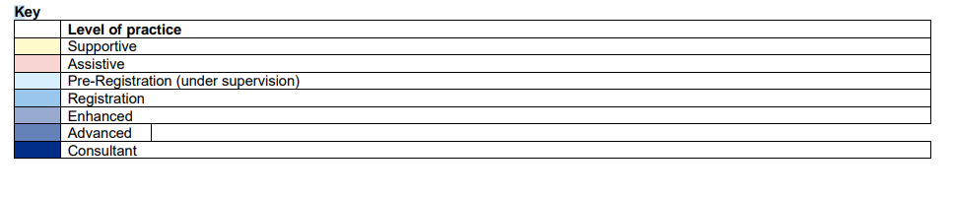
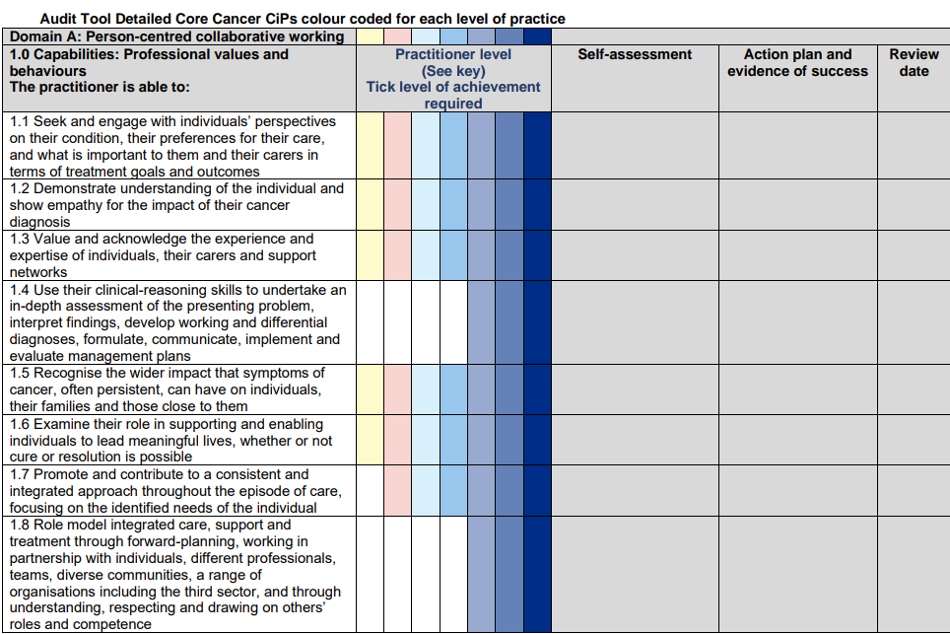
Notes:
This is not just a competency framework
ACCEND elevates the traditional competency approach. We are not asking you for a simple pass/fail checklist. This framework is a dynamic Portfolio of Evidence designed to capture the richness of your professional journey—showcasing your unique skills, lived experience, and deep understanding of cancer care across all four Pillars of Practice.
Each level of practice is highlighted in different colours.
You'll notice the framework is colour-coded according to the seven Levels of Practice. This clear structure provides an instant visual reference, allowing you to quickly identify the minimum core expectations for your current role and see exactly what is required to progress to the next level in your career
The document takes time to complete and is an ever-evolving document... We are not asking people to sit down and complete the self assessment in a few attempts.“
This is an ever-evolving professional document, not a one-off assessment. We actively discourage trying to complete it in a few rushed sessions. It should be seen as a living document that grows with your experience and learning. You only sign off a capability when you feel you have truly achieved it, and you continue to add new evidence over time.
One way to approach the framework is to look at the pillars of practice and choose where you want to start... The framework is not meant to be completed and signed off but added to when you feel that you have achieved a capability
You have flexibility in how you tackle this. Many people prefer a strategic approach using the Four Pillars of Practice (Clinical, Leadership, Education, Research) as their guide. You can: Option A: Start with the pillar where you are most confident to build momentum. Option B: Start with the pillar where you have identified the greatest development need, using it to immediately shape your learning goals.
The designers of the framework recognise that the workforce are time poor and hence why time should be allocated to the team when able to continue to complete the self assessment.“
We recognise that the cancer workforce is time-poor. Therefore, the framework's design directly addresses this by recommending that time for self-assessment and portfolio building must be protected and allocated by managers and teams. This isn't an extra task; it's a fundamental investment in the quality of our service and in your professional future.

Slide 8
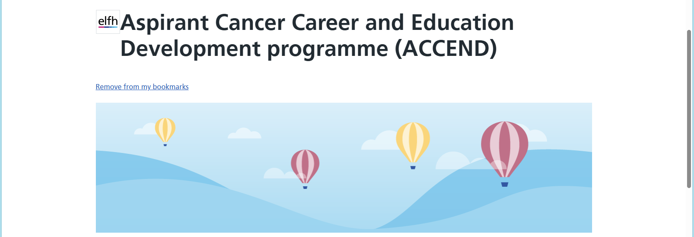
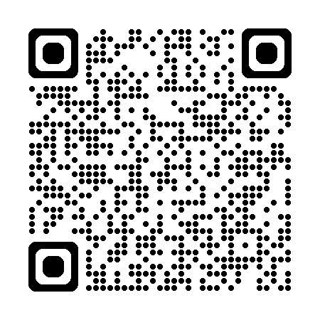
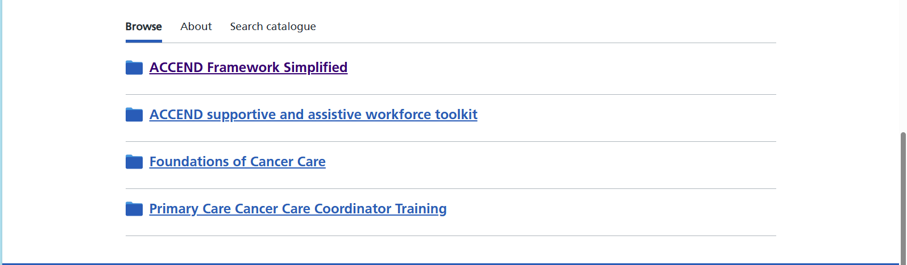
The ACCEND National Learning Hub: (Your Free Resource for Career Growth)
Notes:
This is the QR code for the NHS England education hub. The ACCEND framework is more than just a set of standards; it comes with a dedicated learning resource designed to make implementation simple: the ACCEND National Learning Hub."
"This hub is hosted on the NHS Learning Hub (e-LfH) platform, which means for anyone in the NHS or wider health and social care sector, it is immediately accessible and integrates seamlessly with your existing professional development tools. Think of it as your single, trusted 'go-to' place for all cancer education."
2. The Value Proposition – It’s Free!
"Crucially, I want to emphasize that access to the ACCEND Learning Hub is completely free of charge for the entire cancer workforce. This is a significant investment by NHS England to support your professional development."
"There is no cost to you, your department, or your Alliance. This removes the major barrier of expensive external courses and ensures equal access to high-quality, nationally consistent education, regardless of your location or budget."
3. The "Why" – Practical & Career-Aligned Content
"The hub's content is not just generic learning; it is specifically mapped to the ACCEND Capabilities in Practice (CiPs). This is key: it provides the structured educational content needed to demonstrate competency at every level of the framework—from supportive all the way up to advanced practice."
"You'll find core foundational knowledge, such as the 'Foundations of Cancer Care' modules, and it's continually being developed with resources aimed at all levels of practice, including registered and enhanced roles."
4. The Benefit – Supporting Your Development
"This hub is a vital tool for two things: Self-Assessment and Continuous Professional Development (CPD)."
For the Individual: You can use the resources to fill knowledge gaps identified in your ACCEND self-assessment. It gives you the clear, approved learning needed to achieve the required core capabilities for your role.
For Line Managers: It provides a ready-made, quality-assured syllabus to guide supervision, inform Personal Development Plans (PDPs), and ensure your entire team has the necessary core cancer knowledge.
"In short, the ACCEND Learning Hub is a professional, accessible, and free resource that directly enables you to develop your career, meet your framework capabilities, and ultimately, enhance the quality of care you provide."

Slide 9
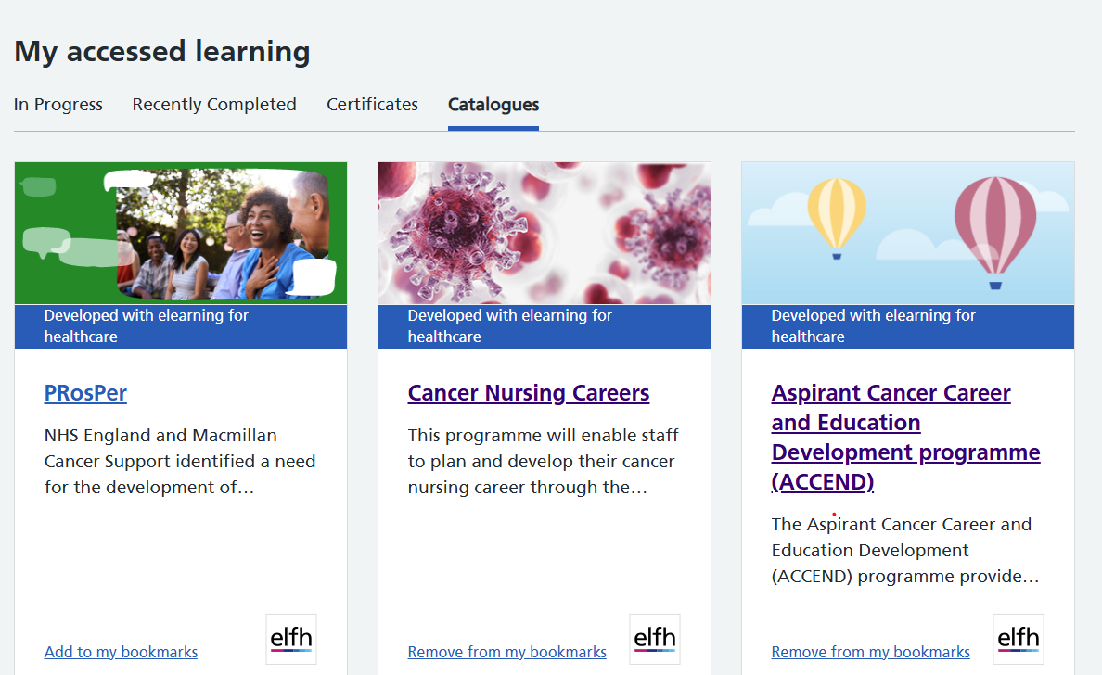
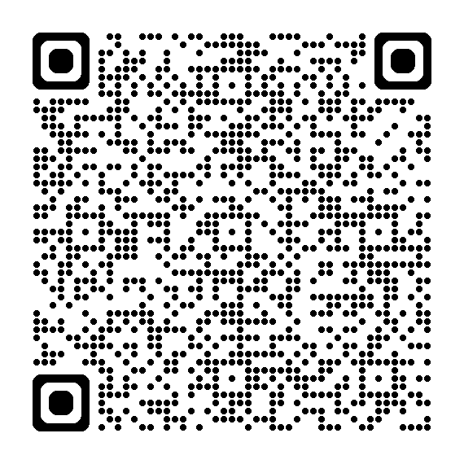
Other Resources on the NHS England Learning Hub
Notes:
The learning hub has consolidated other available education such as Macmillan so is a one stp shop for accessing

Slide 10
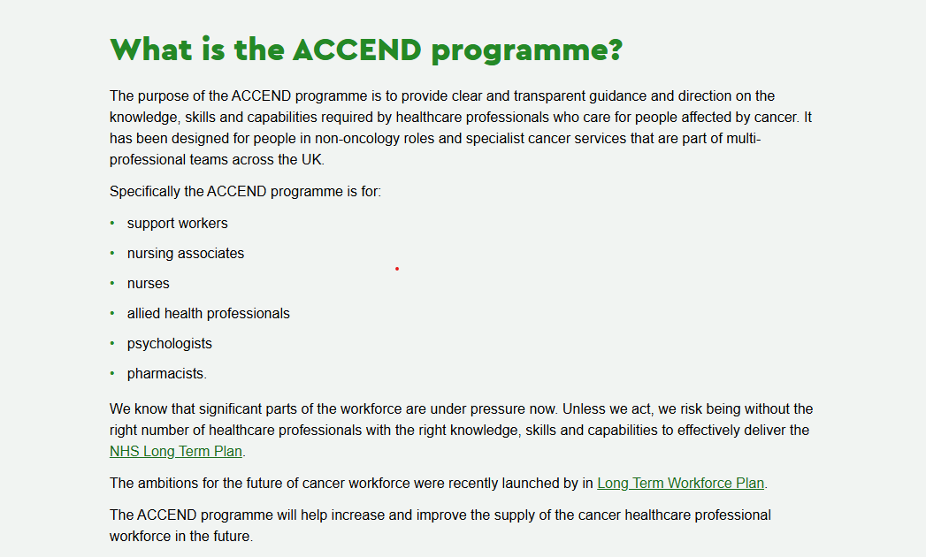
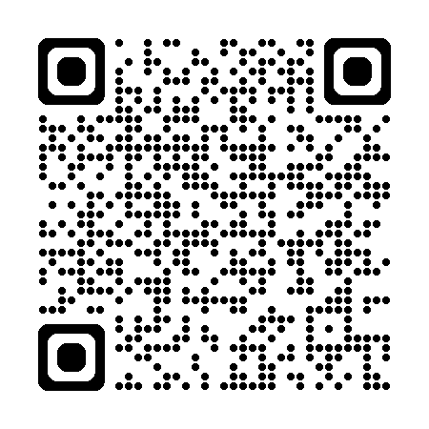
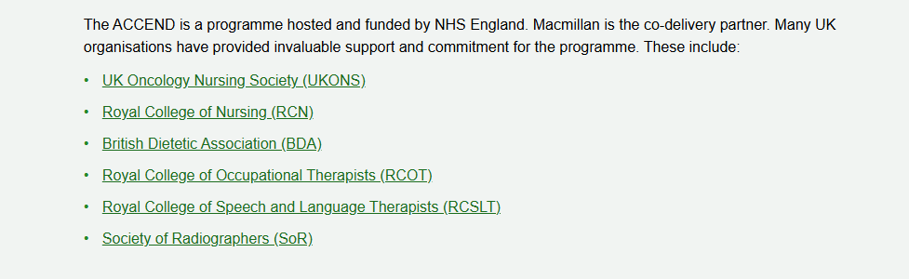
Macmillan & ACCEND
Who is involved with ACCEND?

Slide 11
The future of ACCEND
The Registered, Enhanced towards Advanced (RETA) toolkit and the Leadership, Advanced and Consultant Education and development (LACE) toolkit will be available soon
Currently piloting a Eportfolio on the digital learning solutions platform for possible rollout in April 2026.
Adopting a mentorship programme for staff who want to support staff in self assessing and identifying educational needs
Part 2 being release in next few months
Embedding ACCEND into appraisals and PDRs

Slide 12



Do not edit How to change the design
What challenges do you foresee in implementing the ACCEND framework?
The Slido app must be installed on every computer you’re presenting from

Slide 13

Do not edit How to change the design
What word comes to mind when you think of career development?
The Slido app must be installed on every computer you’re presenting from

Slide 14

Do not edit How to change the design
How would you rate this session?
The Slido app must be installed on every computer you’re presenting from

Slide 15

Thank You

