Slide 1


WEBINAR WEEK 3
Navigating Your Cancer Career Compass
Notes:
Good afternoon, everyone! Welcome to our session on ACCEND Education. My name is Sarah Berwick, and I’m going to guide you through what I feel is one of the most useful components of the ACCEND framework the education part.
The ACCEND framework is all about transforming our cancer workforce, and today, we're giving you the map to your future development.
Over the next 20-30 minutes, we're going to answer three key questions: What is the ACCEND Education Framework? What free education is available right now? And what is upcoming in the future of ACCEND.
Before we look at the specific toolkits, let's briefly recap ACCEND stands for the Aspirant Cancer Career and Education Development program. This is a UK-wide initiative designed to provide a cohesive, structured approach to supporting our entire cancer workforce."
"Its main goal is to promote career progression and ensure consistency in the level of practice across the country. It does this by defining clear Levels of Practice—from Supportive to Consultant—and, crucially, setting out the Core Cancer Capabilities in Practice, or CiPs."
"The CiPs are essentially the measurable standards of knowledge, skills, and behaviour expected at each level.

Slide 2
Supportive
preregistered
Achievement of professional education standards for registration
Graduate level (minimum) (FHEQ 6; CQFW 6; SCQF 10/9) or Postgraduate level registration (FHEQ 7; CQFW 7; SCQF 11) Pre-registration professional apprenticeships
registered
Competency or capability-based development and other role specific training/development Nationally available on-line learning On-going professional development
Graduate level (minimum) (FHEQ 6; CQFW 6; SCQF 10/9) or Postgraduate level registration (FHEQ 7; CQFW 7; SCQF 11) Pre-registration professional apprenticeships. Preceptorship
Competency or capability-based development and other role specific training/development Nationally available on-line learning On-going professional development
Level 2,3 or 4 occupation specific qualification for example, healthcare or senior healthcare support worker (Scottish Vocational Qualification level 2/3; National Progression Award) Care Certificate (England)
Competency or capability-based development and other role specific training/development Nationally available on-line learning On-going professional development
Assistive
Foundation level degree or equivalent level 5 qualification or level 5 apprenticeship (FHEQ 4/5; CQFW 4/5; SCQF7/8) For example, registered nursing associate (England only); assistant practitioner. Care Certificate; Professional Development Award (Scotland level 8 only)
Notes:
As I introduce the ACCEND framework over the next couple of months, you'll see there are clearly defined Levels of Practice, which will be demonstrated across the next two slides. These levels—Assistive and supportive, prereg Enhanced, Advanced, and consultant levels act as your official 'home base' and are typically tied to your formal job title and minimum academic qualifications.
However, I know that we are all dynamic professionals, and in practice, things aren't always so neat! It is incredibly common for elements of your day-to-day role to occasionally push you into a higher level of practice. You might be an Enhanced Practitioner, for instance, dealing with a complex issue that requires an Advanced-level skill. This could be defined as enhanced and working towards advanced.
"The good news? If you can robustly demonstrate that higher-level practice with clear evidence, you should absolutely self-assess against that specific Capability in Practice (CiP) in your portfolio. This shows the scope and depth of your current contribution.
"The key distinction is this: if you do not meet the overall criteria for the higher Level (e.g., you lack the required academic certification), then you should only self-assess your Level of Practice that you are currently employed as. Think of the Level as your official title, and the CiPs as the specific, impressive achievements you collect along the way."

Slide 3
Enhanced
Competency or capability-based development and other role specific training/development Nationally available on-line learning On-going professional development
Postgraduate level: Postgraduate diploma, certificate, modules (FHEQ 7; CQFW 7; SCQF 11) Graduate certificate/modules: (FHEQ 6; CQFW 6; SCQF 10/9) Enhanced clinical practice apprenticeship. Completion of local or national post registration role-specific requirement
Advanced
Competency or capability-based development and other role specific training/development Nationally available on-line learning On-going professional development
Masters level (FHEQ 7; CQFW 7; SCQF 11) Advanced practice apprenticeship achievement of nation requirements for recognition as advanced practitioner
Consultant
Competency or capability-based development and other role specific training/development Nationally available on-line learning On-going professional development
Doctoral level (FHEQ 8; CQFW 8; SCQF 12) Achievement of nation requirements for recognition as consultant
Notes:
So, how do we use this distinction to progress your career? This is where the framework becomes a powerful tool for progression.
If you are consistently operating at the higher level of CiPs, this needs to be a core subject for your appraisal discussion with your line manager. This documented evidence is crucial, especially for those who are focused on career progression and looking to move into that next bracket.
Your self-assessment against the framework isn't just a record of the past; it's a justification for the future. It clearly shows that you are already operating with the capabilities needed for the next step, making a strong case for taking on extra education or applying for a higher-banded role.
"For example: I must officially self-assess at the Enhanced level because I don't possess a Master's in Advanced Practice. But, as a Band 7 Team Lead, I have Level 2 psychological skills and use them daily within my clinical practice. Therefore, I can confidently claim the Advanced CiP of 'Consistently role model highly developed interpersonal and advanced communication skills...'
"I claim the Capability, but not the Level. This tells my manager, and the Trust, that I'm performing at a high capacity and that investing in the necessary Master's degree is the logical next step to formalise my practice and align my Level with my Capabilities."
Many cancer practioners work at a higher level because of their experience and skills developed over years of clinical practice. Many people who are aligned within the enhanced level of practice will practice in some area at a higher level. The evidence provided can be both informal and formal. For instance, you could provide a patient consultation as part of your evidence and define the areas that meet the advanced level of practice to fulfil that capability.

Slide 4
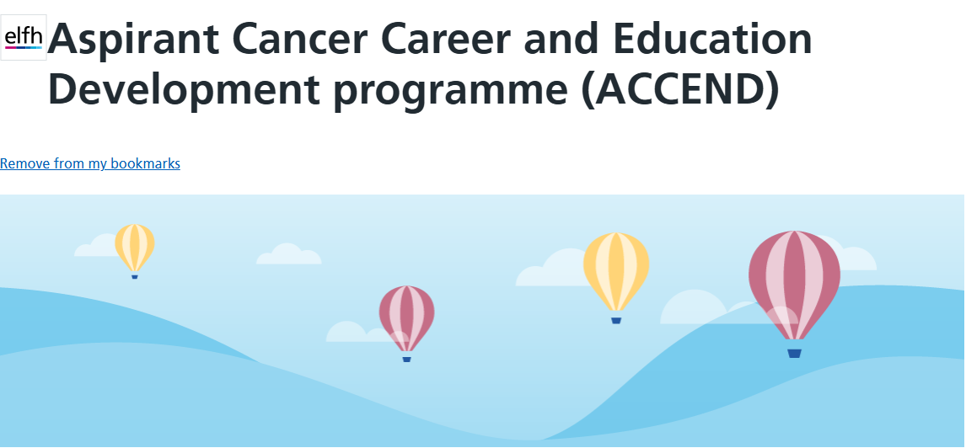
National Learning Hub
Notes:
So moving on to the education part of ACCEND.
The ACCEND Hub acts as a digital "go-to" place, hosted on the NHS Learning Hub (e-learning for healthcare/e-lfh platform).
So, what is Currently Available on here?
The initial deployment of the ACCEND Hub strategically prioritised establishing a core educational baseline and essential tools for prereg staff and the supportive and assistive workforce:
Firstly is the Foundations of Cancer Care E-Learning Programme with Nine Modules:
This flagship course delivers essential core knowledge across critical domains (e.g., the science of cancer, personalised treatment pathways, and palliative care). It is designed for the Pre-registration workforce, especially useful for them on cancer-based placements .
Secondly is the Supportive and Assistive Workforce Toolkit:
Provides practical resources, such as Role profiles within supportive and assistive workforce, Role profiles within cancer care, ACCEND framework simplified.
And Thirdly Framework Implementation Resources:
Full access to the official Framework documents and Implementation Guides.
Visual aids, including animations and detailed role profiles (e.g., CNS, OT), which dynamically illustrate Framework application and career progression.
The ACCEND hub is continually evolving, with a focus on expanding coverage to higher career levels and enhancing usability:
One being the RETA hub and Leadership Content:
Development and launch of dedicated learning content for the Registered, Enhanced, towards Advanced (RETA) levels of practice including a course finder tool.
New modules introduced focusing on Consultant and Strategic Leadership roles.
2
Macmillan Cancer Support (Source 1.1, 1.6)
Cheshire & Merseyside Cancer Alliance (Source 1.2)
RCN Cancer Forum (Source 2.4)

Slide 5

Learning Hub
ACCEND framework simplified for all levels of practice
ACCEND supportive and assistive workforce toolkit
Foundations of Cancer Care - pre-registered workforce
Primary Care Cancer Care Coordinator Training
Notes:
The hub has a area were the ACCEND Framework is Simplified
you can Learn more about the ACCEND framework and how it relates to your role in cancer care. The framework is for the supportive, assistive, nursing and allied health professions workforce who provide care to people affected by cancer in general and within the specialist cancer settings, services and roles across the UK.
Currently, there are sessions which cover the ACCEND framework and role profiles within cancer and specifically in supportive and assistive level of care. More sessions will be added later to cover other levels. Additionally, there are also programmes for Foundations of Cancer Care and Primary Care Cancer Care Coordinator.
The ACCEND supportive and assistive workforce toolkit shows that the this workforce is a diverse group within nursing, allied health, administrative, and pharmacy teams, providing clinical, navigational, and administrative support across various settings like GP surgeries, hospitals, community centers, and patients' homes. These sessions include the role profiles working in cancer care as well as some recommended resources.
Foundations of Cancer Care
Foundations of Cancer Care is a comprehensive elearning programme mainly designed and developed for pre-registration nursing and allied health professional students although it is recommended for anyone interested in increasing awareness in cancer care.
The Primary Cancer Care Coordinator training is designed to provide users with essential information on the significance of cancer prevention, screening and early diagnosis. Including addressing health inequalities and holistic care of patients affected by cancer.

Slide 6
RETA and LACE toolkit
The Registered, Enhanced towards Advanced (RETA) toolkit and the Leadership, Advanced and Consultant Education and development (LACE) are both currently in development and will be also made available on the National Learning hub.
Notes:
As mentioned before the ACCEND hub is continually evolving, upcoming is both the RETA and LACE toolkits
RE
These toolkits will be dedicated learning content for the Registered, Enhanced, To Advanced (RETA) levels of practice.
LACE toolkit focusing on Consultant and Strategic Leadership roles.
These tool kits are currently being developed and will be launched onto the National learning hub hopefully early next year.

Slide 7


Macmillan learning Hub
Notes:
There is also Additional access to free education via the Macmillan website and you don’t have to be a Macmillan professional to access it. All the education is aligned to the ACCEND framework. This education is free to anyone who works within health care and is primarily focused on the supportive and assistive workforce. All the education is mapped to the ACCEND framework.
Please go and check out these really good sites and I will inform you all when the hub has been updated to include more resources when it happens.

Slide 8
New and next Steps in ACCEND
Completion of digital learning solutions digital ACCEND portfolio end of December
Updated version of ACCEND version 2.0
Funded ‘principles of cancer care’ for the supportive and assistive workforce
UK wide pre reg cancer curricula guidance for HEIs
Development and roll out of a national course finder
Completion of a workforce survey and results The_results_of_the_ACCEND_2025_NHS_cancer_workforce_in_England_survey.pdf
Fundamentals of cancer care course
Notes:
3. Framework Modernisation:
Digitisation of the ACCEND Framework to improve user experience, engagement, and ease of self-assessment and progression tracking.
Updating the Framework itself to formally incorporate education and research career pathways.
4. Education Standardisation:
Delivery of standardised education for the supportive and assistive workforce (e.g., 'Principles in Cancer Care').
Development of UK-wide pre-registration cancer curricula guidance for Higher Education Institutions.
There is currently development and roll out of a National course finder this is will allow people to look for available national training and education mapped to certain CIPs. After completing your self assessment against the capabilities of practice any identified gap in skills and knowledge this course finder will allow you to identify the education you need to fulfil those capabilities but also be able to find what education if available for people who want to progress to the next level of practice. Although all the mapping has been completed the tool is still under development to ensure that the course finder is accessible and easy to navigate.
5. Workforce Intelligence:
Completion of a baseline workforce survey across England to inform future training design and close skill gaps identified by the programme. The link is here to access the survey for yourself I am very happy to send the link if anyone wants to look at it.
. Fundamentals in Cancer Care:
Creation of the next tier of education, 'Fundamentals in cancer care', specifically targeting the Registration, Enhanced, Advanced, and Consultant levels. This course can be a stand alone course or part of a Masters in advanced care when education tool finder is introduced there will be information on this course

Slide 9
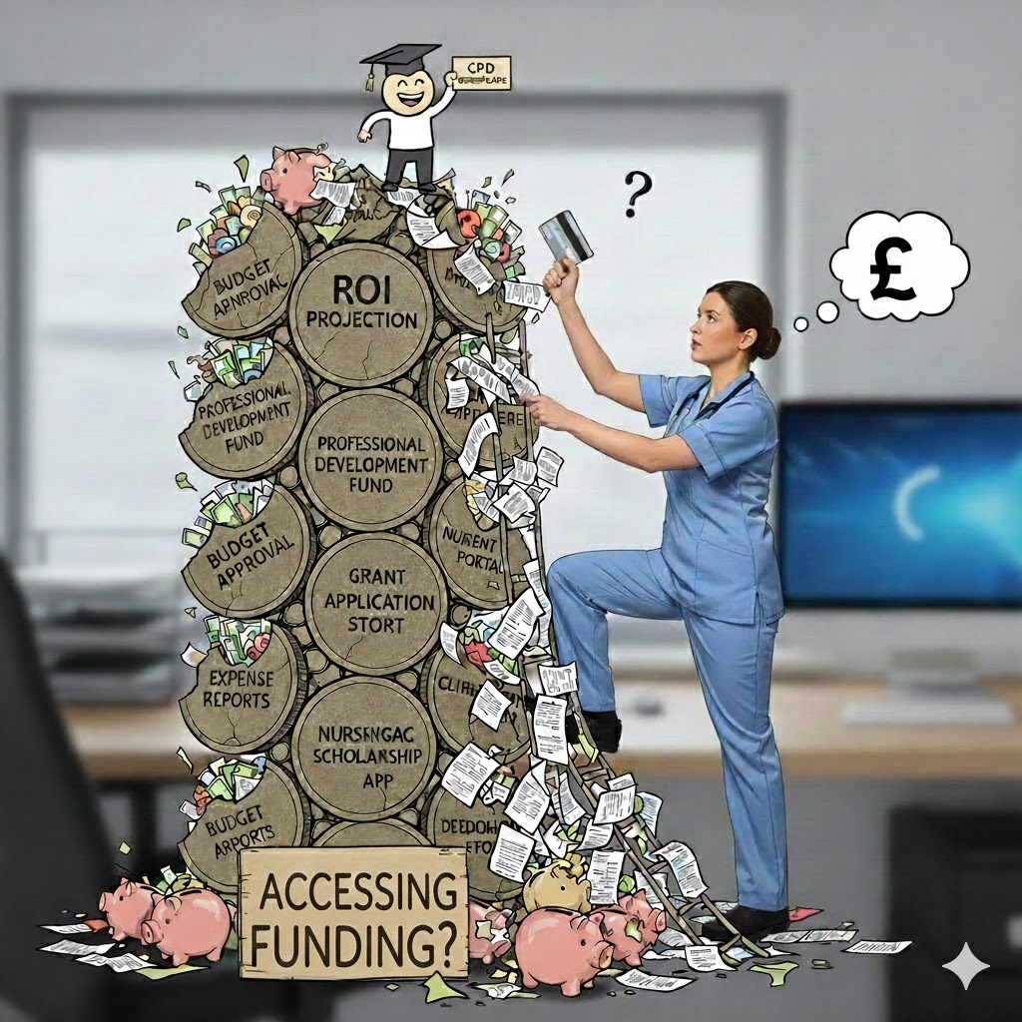
Funding
Notes:
We can all empathise how difficult and onorous it is to secure funding for courses. From personal experience I have spend hours filling out forms and gaining access to portals to book trains, accommodation and booking places on courses. Education is the back bone of our clinical practice and should not be such a task to obtain funding.
There are places to get funding I cannot always make it less onerous but I intend to make funding a little more accessible. The Humber and North Yorkshire cancer alliance has ring fenced funding for education each year specifically course that can be mapped to ACCEND. And there has been tens of thousands of pounds approved for CPD and innovation education. We are currently in the process of developing an area on out cancer alliance website that will allow people easy access to apply for this funding and go through the process.
If you are Macmillan professional, then you will have access to £1000 pounds of individual funding and £5000 for team funding. If you are not a Macmillan professional and feel that this would align with your role, Macmillan are now adopting professionals and you can apply for this via Macmillan.
The trusts do offer some CPD funding also for certain education and conferences.
I hope to work with the cancer alliance comms team to make all this information available on the alliance website.
In the meantime if you are unsure about future funding, you can contact me or Alicia Maultby the Cancer Alliance’s Clinical and Professional Nursing and AHP Lead.

Slide 10
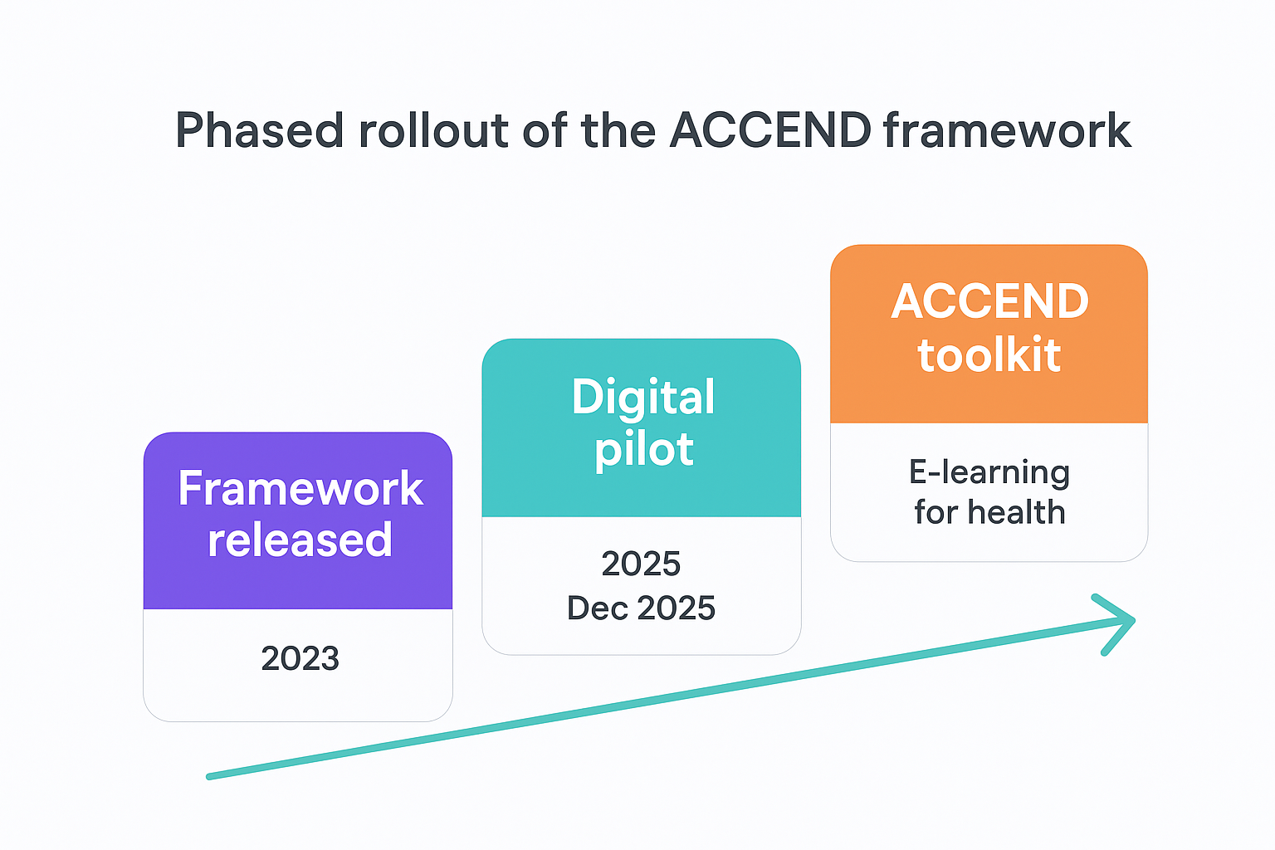
ACCEND long term rollout
Notes:
To conclude, I want to address the timeline. ACCEND is a phased rollout.
Phase 1 has focused on the foundational resources: the Supportive and Assistive Workforce Toolkit and the Foundations of Cancer Care modules.“
"The development of RETA and LACE is Phase 2. Work is actively underway to create this content, building upon the infrastructure already established. They will be launched once the foundational toolkits are fully implemented and reviewed.“
"The key takeaway is that these resources are coming, and they represent a huge step forward for structured career progression. Please keep checking the official ACCEND Learning Hub for announcements regarding their release and I will also keep people informed of any developments

Slide 11

Any Questions?

Slide 12

Thank You
Notes:
To conclude, I want to address the timeline. ACCEND is a phased rollout.
Phase 1 has focused on the foundational resources: the Supportive and Assistive Workforce Toolkit and the Foundations of Cancer Care modules.“
"The development of RETA and LACE is Phase 2. Work is actively underway to create this content, building upon the infrastructure already established. They will be launched once the foundational toolkits are fully implemented and reviewed.“
"The key takeaway is that these resources are coming, and they represent a huge step forward for structured career progression. Please keep checking the official ACCEND Learning Hub for announcements regarding their release and I will also keep people informed of any developments

